Slide 1
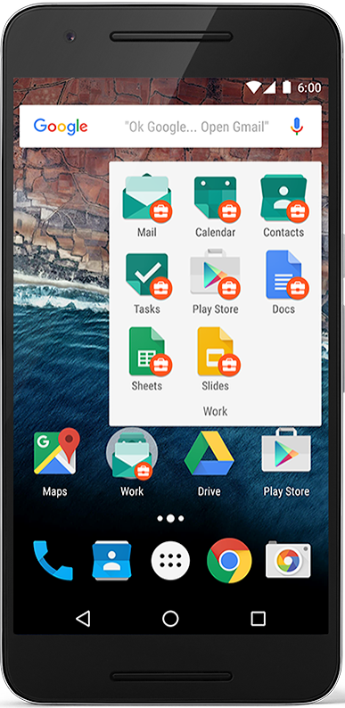
Android home screen
Launcher icons for apps
Self-updating widgets for live content
Can be multiple pages
Folders to organize apps
"OK Google"

Slide 2
Android Software Developer Kit (SDK)
Development tools (debugger, monitors, editors)
Libraries (maps, wearables)
Virtual devices (emulators)
Documentation (developers.android.com)
Sample code

Slide 3
Android Platform Architecture
This work is licensed under a Creative Commons Attribution-NonCommercial 4.0 International License

Slide 4
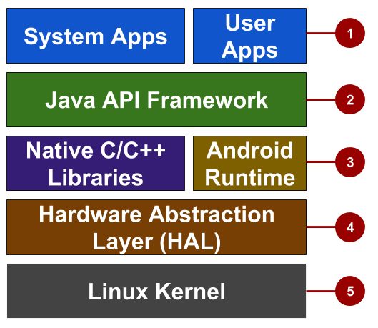
Android stack
System and user apps
Android OS API in Java framework
Expose native APIs; run apps
Expose device hardware capabilities
Linux Kernel

Slide 5
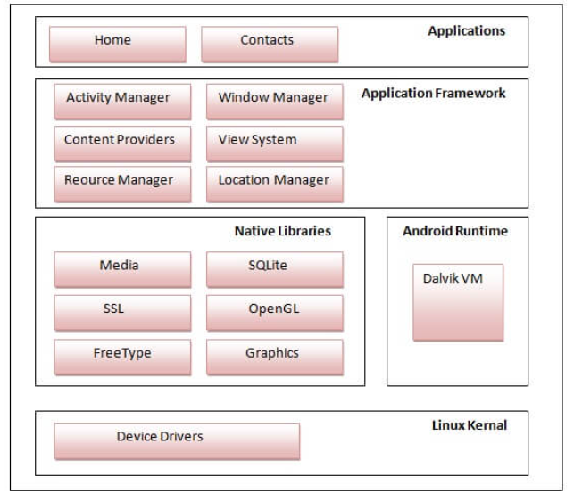
Android stack

Slide 6
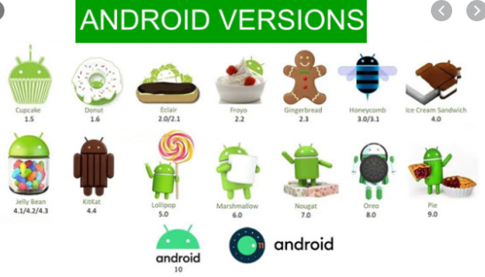

Slide 7
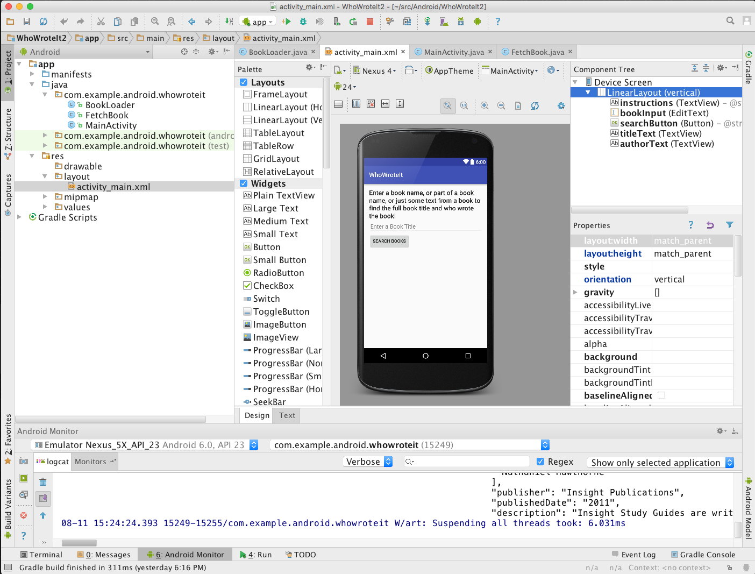
What is Android Studio?
Android IDE
Project structure
Templates
Layout Editor
Testing tools
Gradle-based build
Log Console
Debugger
Monitors
Emulators

Slide 8
Android Studio
Official Android IDE
Develop, run, debug, test, and package apps
Monitors and performance tools
Virtual devices
Project views
Visual layout editor

Slide 9
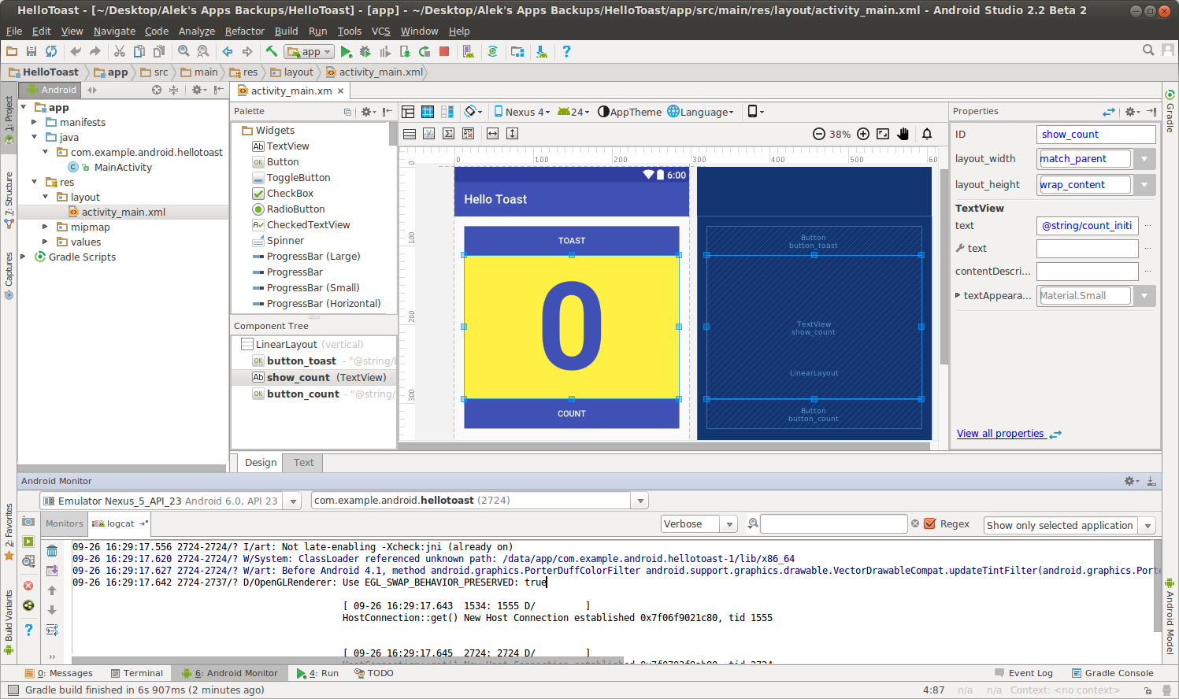
Android Studio Panes
Layout Editor
Project
Files
Android Monitors:
logcat: log messages

Slide 10
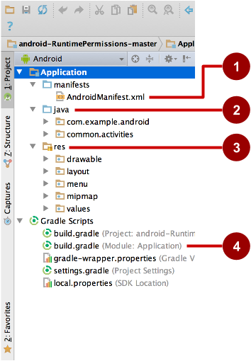

Slide 11
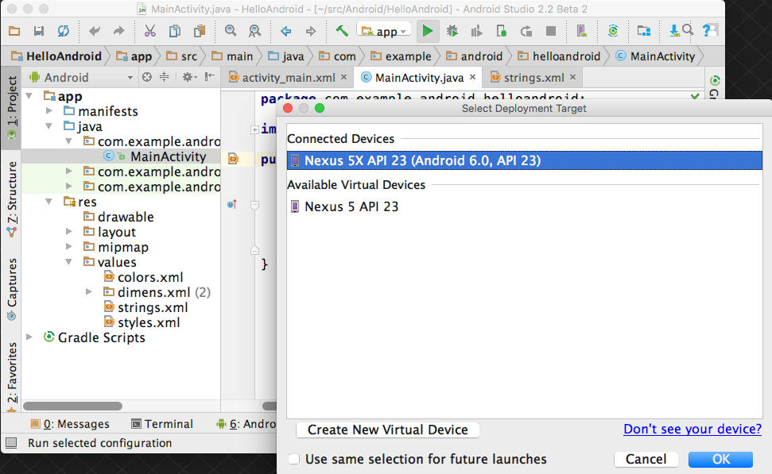
Run your app
Run
2. Select virtual or physical device
3. OK

Slide 12
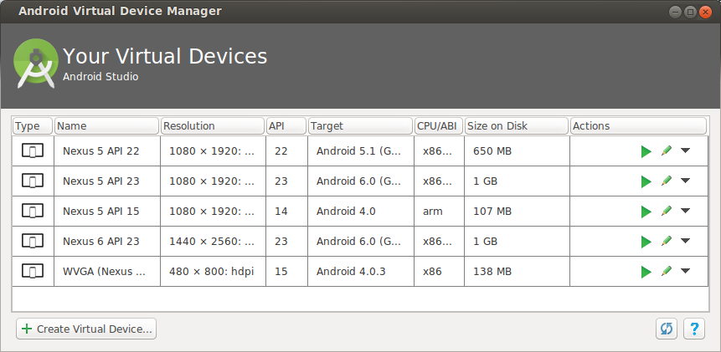
Create a virtual device
Use emulators to test app on different versions of Android and form factors.
Tools > Android > AVD Manager or:

Slide 13
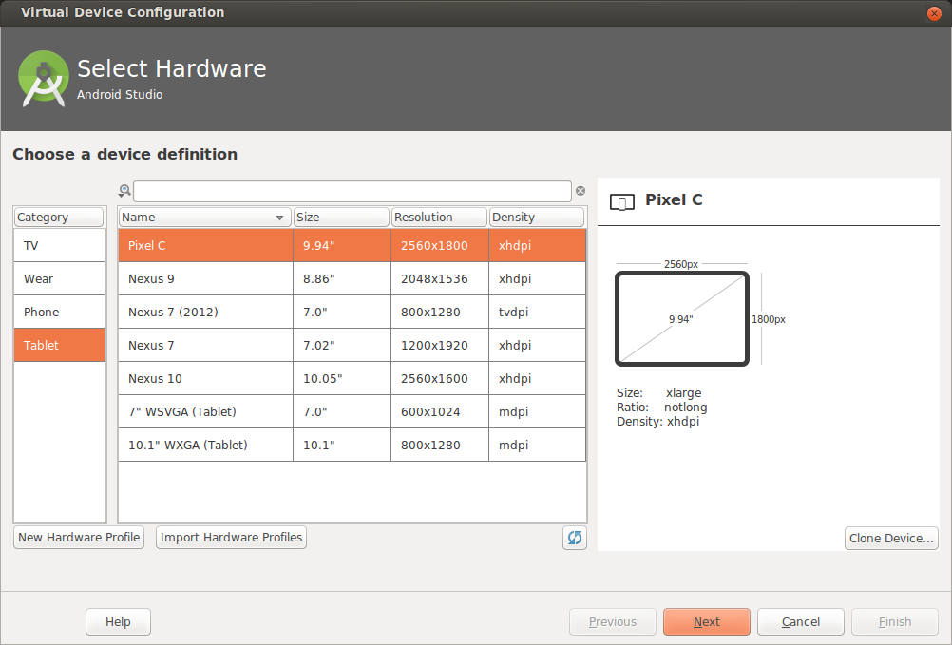
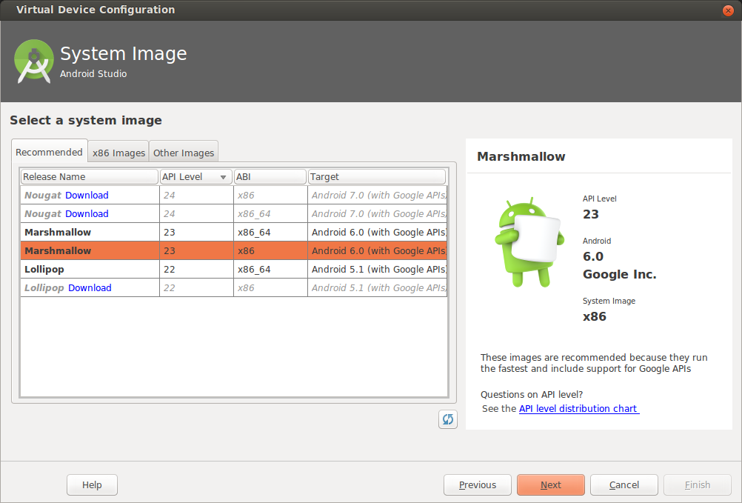
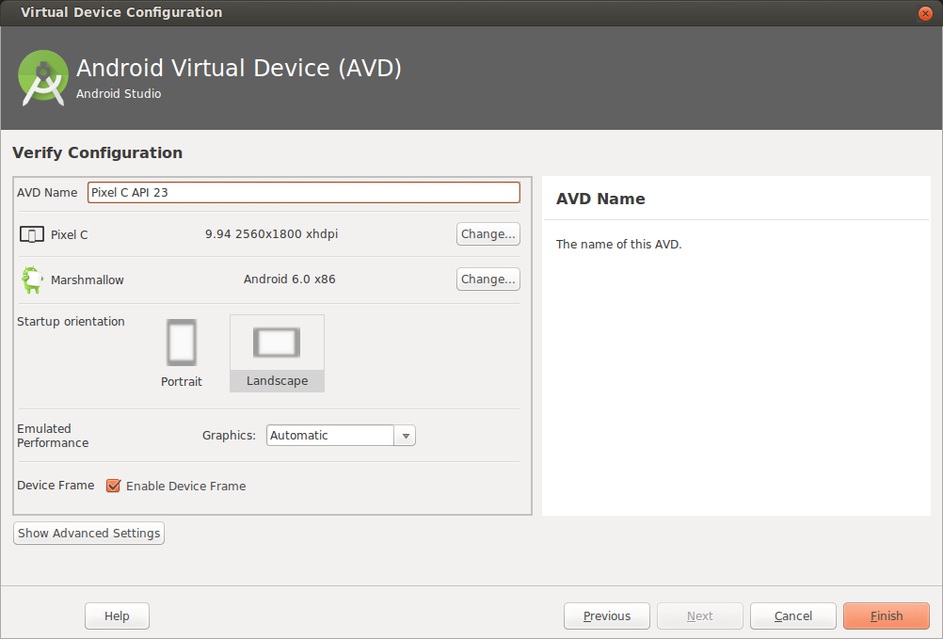
Configure virtual device
Choose hardware
2. Select Android Version
3. Finalize

Slide 14
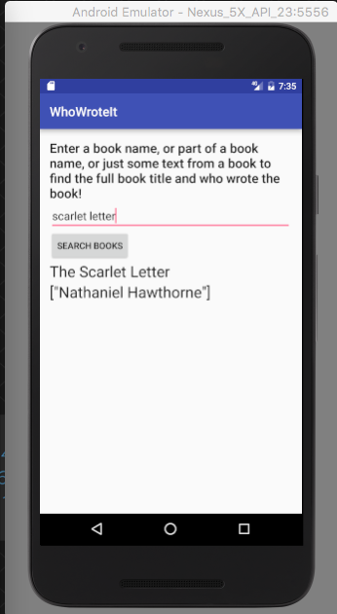

Run on a virtual device

Slide 15
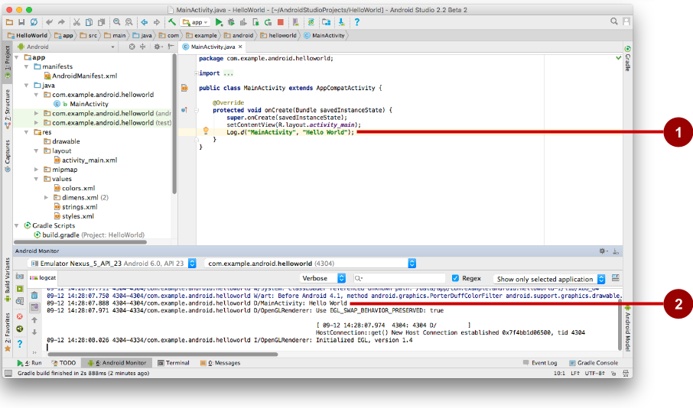
Android Monitor > logcat pane
Log statements in code.
logcat pane shows system and logging messages
Set filters to see what's important to you
Search using tags

Slide 16
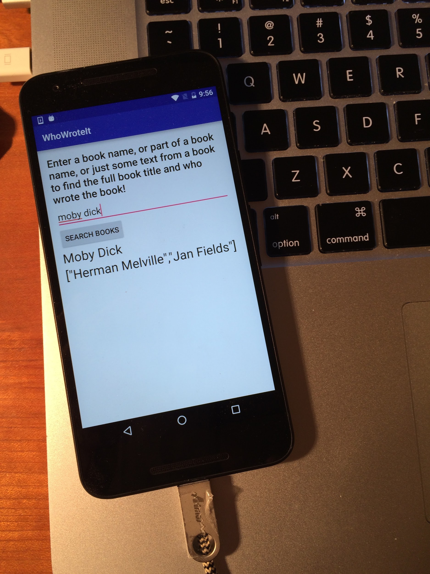
Run on a physical device
Turn on Developer Options:
Settings > About phone
Tap Build number seven times
Turn on USB Debugging
Settings > Developer Options > USB Debugging
Connect phone to computer with cable
Windows/Linux additional setup:
Using Hardware Devices
Windows drivers:
OEM USB Drivers

